Slide 1
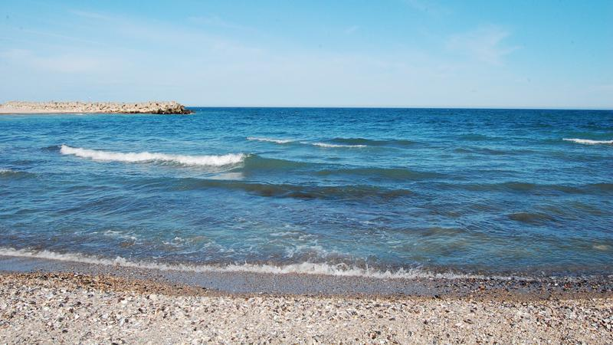
Cooperation for innovation and the exchange of good practices ”MER EN VUE-SEA IN SIGHT”
”Viceamiral Ioan Murgescu” Secondary School
Valu lui Traian- Romania
MARINE POLLUTION
SAVING our Sea !

Slide 2
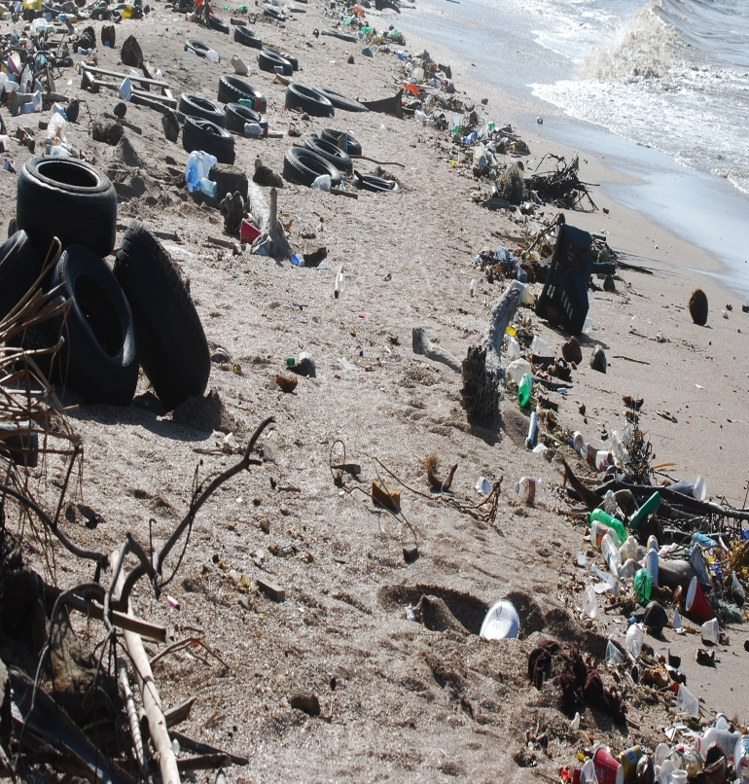
The Black Sea is polluted with agricultural waste (different types of fertilizers) of origin
animal, household and industrial, as well as with
organic and inorganic nutrients from different sources. Most of the nutrients are brought in
in the sea of rivers. An increase in concentration
of nutrients leads to excessive development of
population of fi toplankton, a phenomenon called
"Eutrophic."

Slide 3
Every year, a large amount of substances
pollutants reach the seas and oceans. One of the main pollutant is oil. Leaks on oil tankers or in areas in reserve exploration activities take place oil spills, accidents and deliberate spills are the main causes this pollution.

Slide 4
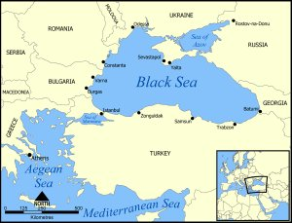
In the Black Sea, oil pollution is concentrated in coastal areas. This comes from permanent sources such as estuaries, waste water points, ports and industrial areas.

Slide 5
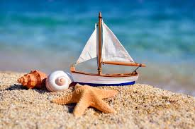
Saving our Sea !

