Slide 1
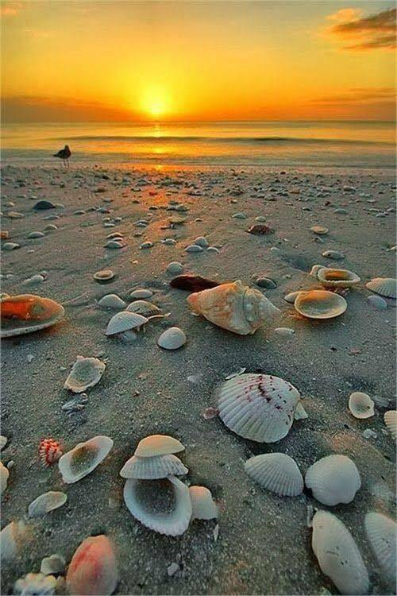
Cooperation for innovation and the exchange of good practices
”MER EN VUE-SEA IN SIGHT”
”Viceamiral Ioan Murgescu” Secondary School
Valu lui Traian- Romania
The Sea Daimon
The Legend of the Sea Monster

Slide 2
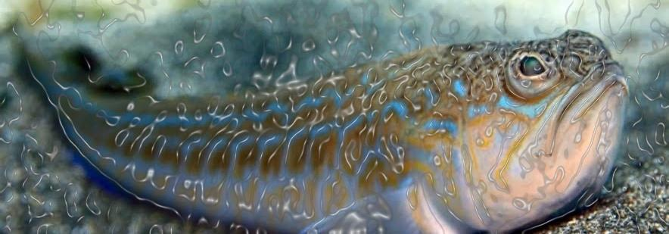
It is said that every river, sea or ocean has a mythical master, an enormous fish like monster who punishes people.
The legend says that the biggest sea monster lies deep down in the waters of the Black Sea.
The Sea Daimon
The Legend of the Sea Monster
Lumea spune că arată ca un peşte uriaş, dar de fapt, nimeni nu l-a văzut vreodată bine…

Slide 3
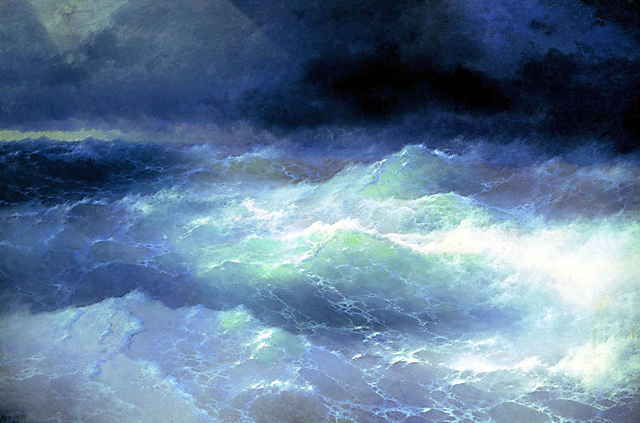
When he was angry on people, he came out of his palace, sucked in the shallow sea-water and created a lot of large whirlpools and waves, drowning both sailors and ships.

Slide 4
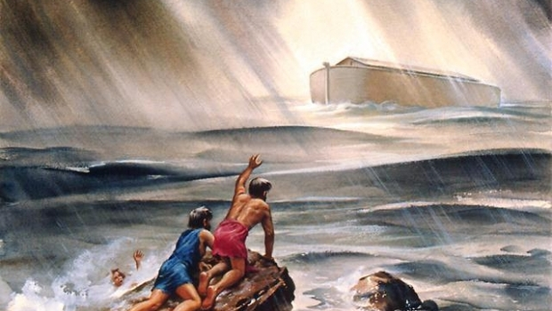

Slide 5
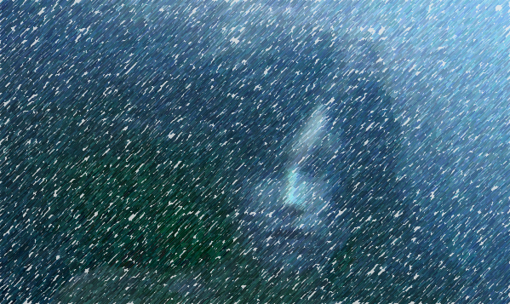
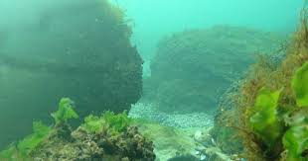
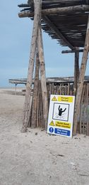
The legend says that the Sea Monster hides in a white whirlpool and he “swallows” everything, from birds to ships and even islands.

Slide 6
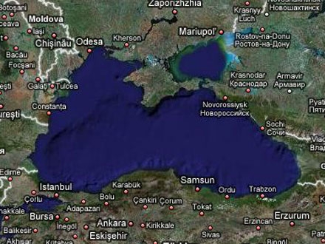
Most of the time he destroys all the things he encounters near the mouths of the Danube and the Snake Island.
It is said that there was his realm, but he wandered the entire sea, sometimes reaching the Bulgarian or Turkish shore.

Slide 7
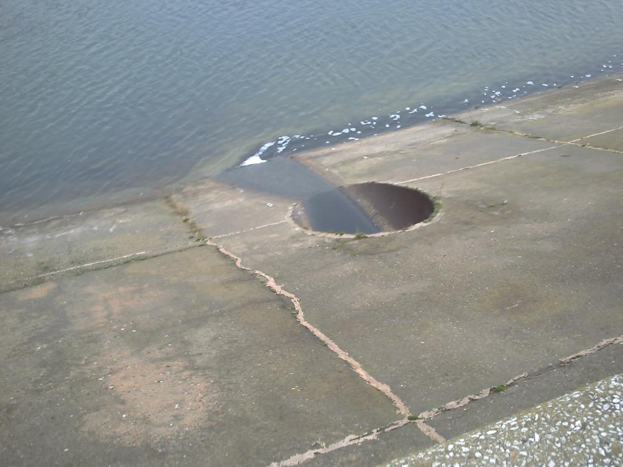
The End
P.S. Everything is pure fiction, of course! ☺

