Slide 1
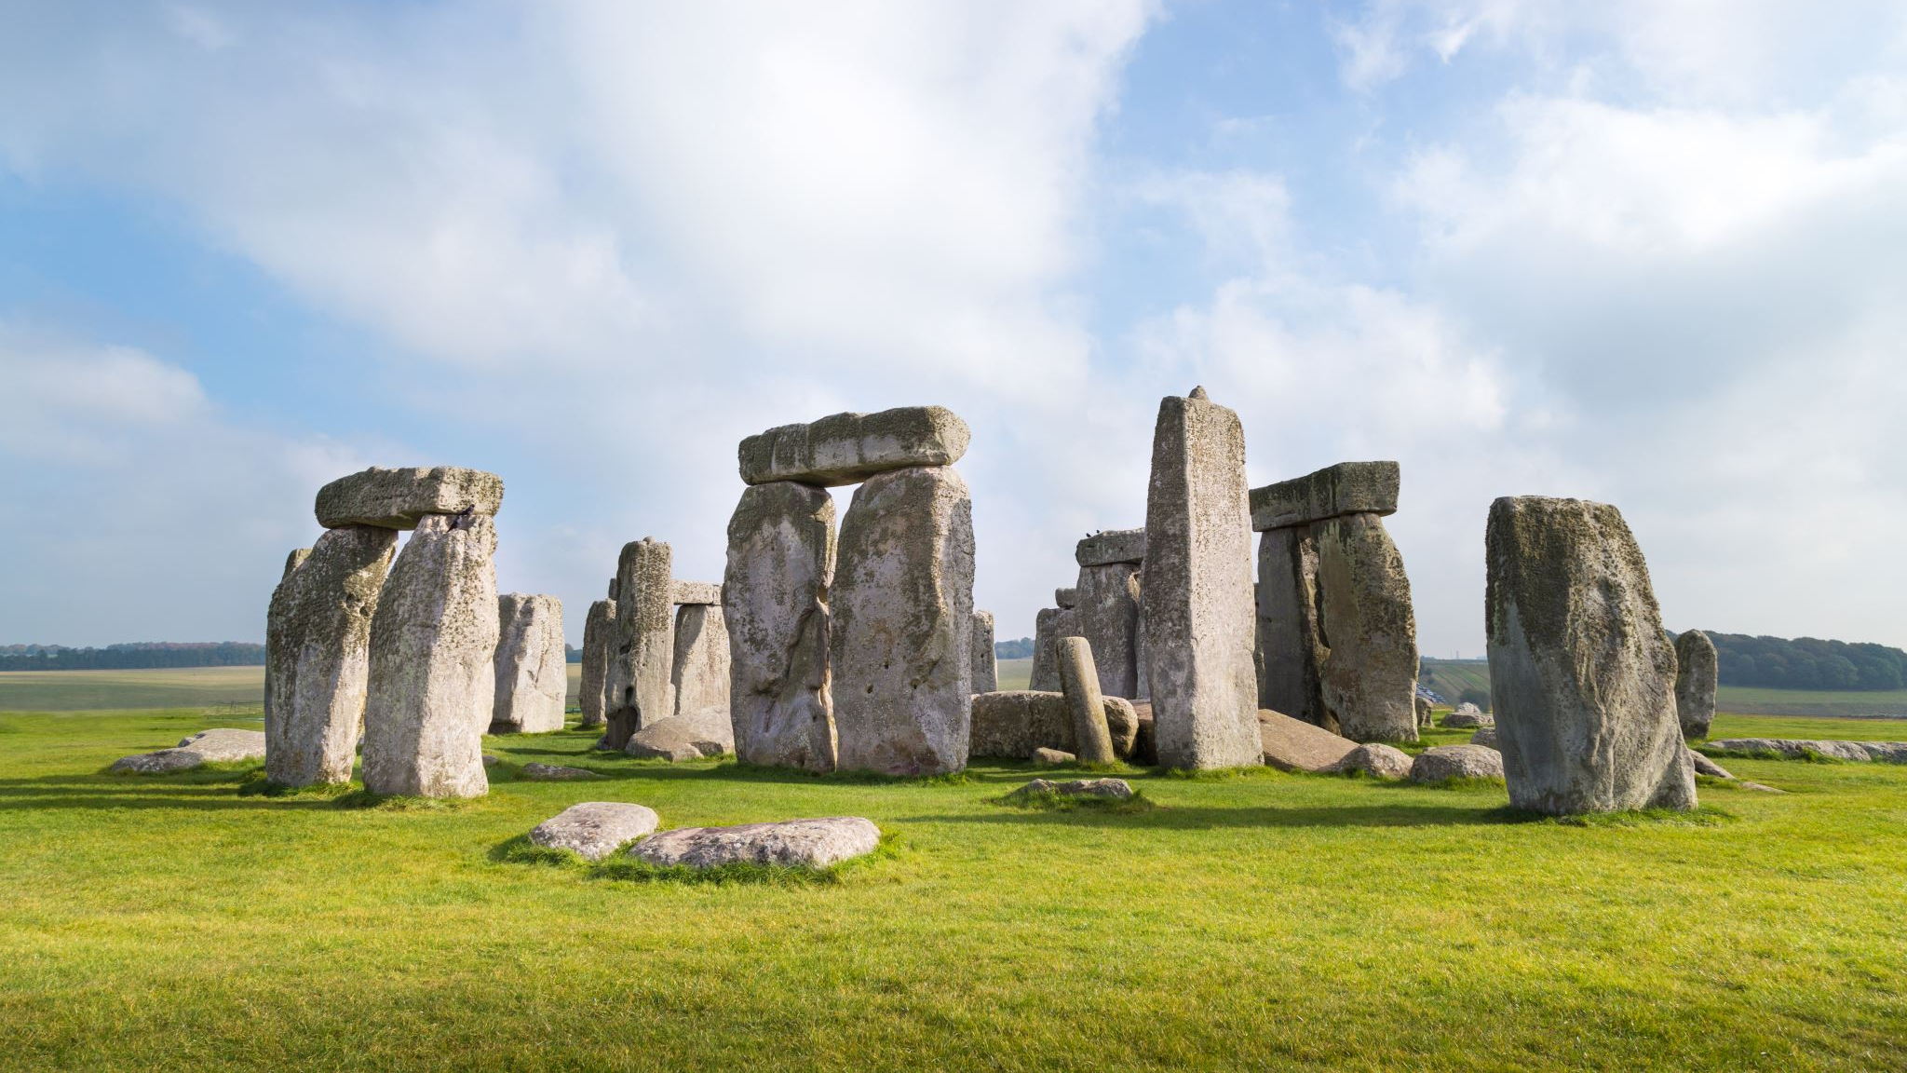
LOCAL MYTHS AND LEGENDS CROATIA

Slide 2
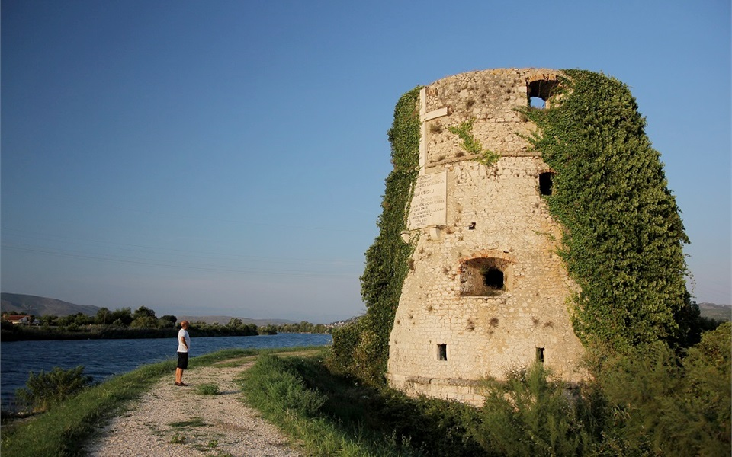
THE NORINSKA TOWER
Norinska Tower is a monumental fortress from the 16th century
It is located along the river Neretva, opposite the mouth a tributary of the Norin after which the tower was named, and right next to the main road at the entrance to the city Metković
The cultural property is protected.
The history of the Norinska Tower is also the history of the entire Valley Neretva
Due to its sights and historical memories, the settlement originated on the other side of the Neretva, after which it was named – Kula Norinska, and today is the seat of the municipality of the same name.
The tower was raised as a defender of the Turkish Empire from the Venetian invasion ships to the Neretva.
It was used for military purposes until the 19th century when it was converted into a windmill, and is valuable today cultural monument
Unfortunately, it is quite neglected and overgrown with ivy

Slide 3
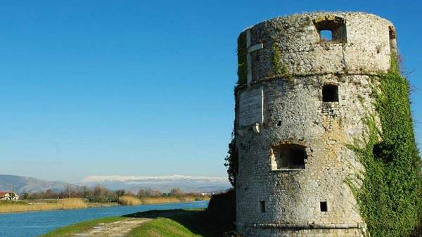
THE LEGEND OF THE NORIN KING
King Norin lived a long time ago
He was very ugly, he had a pig's head, legs donkey and goat ears
He lived in Norinska Tower
They came to shave him every day, but the king didn’t want people to know how ugly he was so he killed barbers
To one barber, his mother made a cake out of her milk
King Norin did not want to kill him because they were brothers in his mother's milk, so he set him free and told him to keep his secret
The king told him to dig a hole and that he could just told how ugly he was to that hole
From a hole in the ground grew a plant that sang, "King Norin's head is made of yarn, his legs are made of donkey, his goat's ears."
The king jumped off the tower because of that
He crawled in Opuzen, was seen in Vid and then drowned
His chin grew from the eel

Slide 4
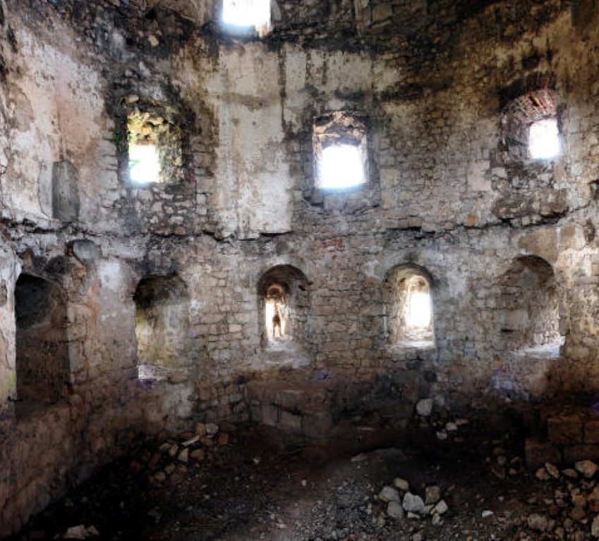
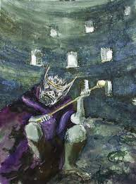

Slide 5
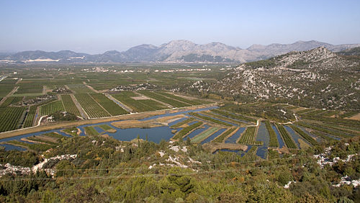
MARY'S WREATH (Marin vijenac)
The first peak in a row of "Žaba" Mountain, 507 meters high
The ascent trail starts from the small village of Mlinište
Along the trail are small stone crosses and figures
At the top is a 7-meter-high cross erected by high school students in 1995
Herds of horses can be found at the foot of the peak, which could soon become a sensation for tourists
Mary's wreath is named after the double row of stone cliffs that surround the top like a wreath
It has an unforgettable view of the Neretva valley and cultivated fields
This Photo by Unknown author is licensed under CC BY-SA.

Slide 6
THE LEGEND OF MARY'S WREATH
Once upon a time there lived a girl named Mara
Every day she wove wreaths of daisies and spent time tending flocks of sheep
One day while the Ottomans were attacking this place they tried to rape her
To prevent them from doing so, in a hopeless situation, the girl jumped from the top of the hill and killed herself
That is why the hill is called Mary's wreath according to folk legend
And according to the rest of the story, the Ottomans killed everyone who remained in the area

Slide 7
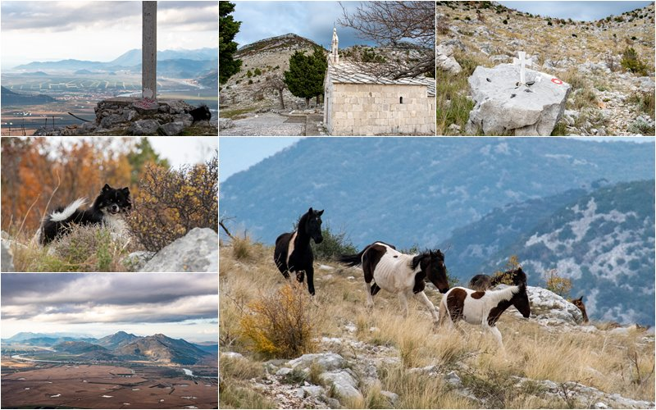

Slide 8
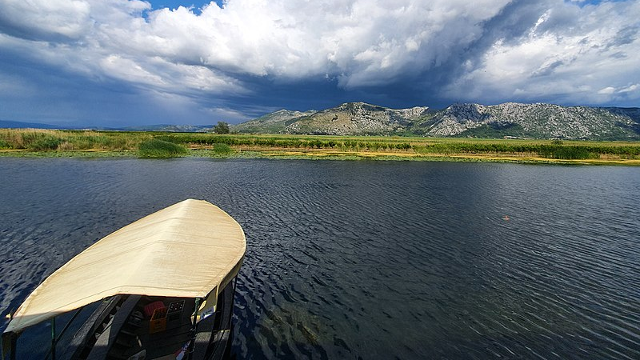
LAKE KUTI
Kuti is an alluvial lake and cryptodepression near Badžula and 6 km from Opuzen
It is fed by water from several springs on the east coast
It is not isolated from major watercourses
It is connected to the Neretva by the rivers Crna rijeka and Mislina
In summer, the water level is low and on that occasion an islet appears in the middle of the lake
Decree of the Government of the Republic of Croatia of 20 August 2020. Kuti declared a protected area as a special ornithological reserve
The reserve includes Lake Kuti and wetland habitats along the lake
Diverse wetland habitats have been developed in the area of ​​the reserve, and this area is especially important for the preservation of the nesting population of wetland birds and the population of birds migrating along the Adriatic migration route
This Photo by Unknown author is licensed under CC BY-SA.

Slide 9
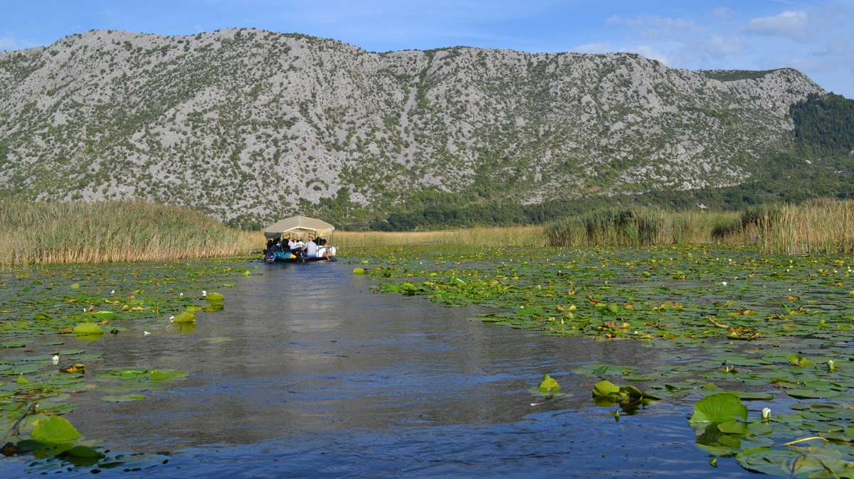
THE LEGEND OF THE LAKE KUTI
Once upon a time there was a big city, at the place where the lake is now.
Many people lived there until one day.
According to the story, a poor man came to the city begging for food, but no one wanted to give him anything, so they expelled him from the city.
Soon after, the city was hit by a great flood, so the whole population died, and so the lake was created.
According to the story, it is believed that this man was a saint who had the power to do such a thing to a greedy city.
One of the stories believes that it was the long-submerged Troy, because King Agamemnon and Odysseus set out on a journey from Ithaca in the Ionian Sea across the Adriatic Sea, and the lake has access to the Adriatic Sea
When the weather is clear, you can see the remains of ruins by sailing on the lake

Slide 10
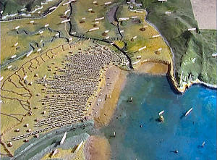
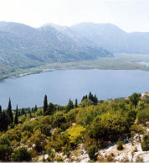

Slide 11
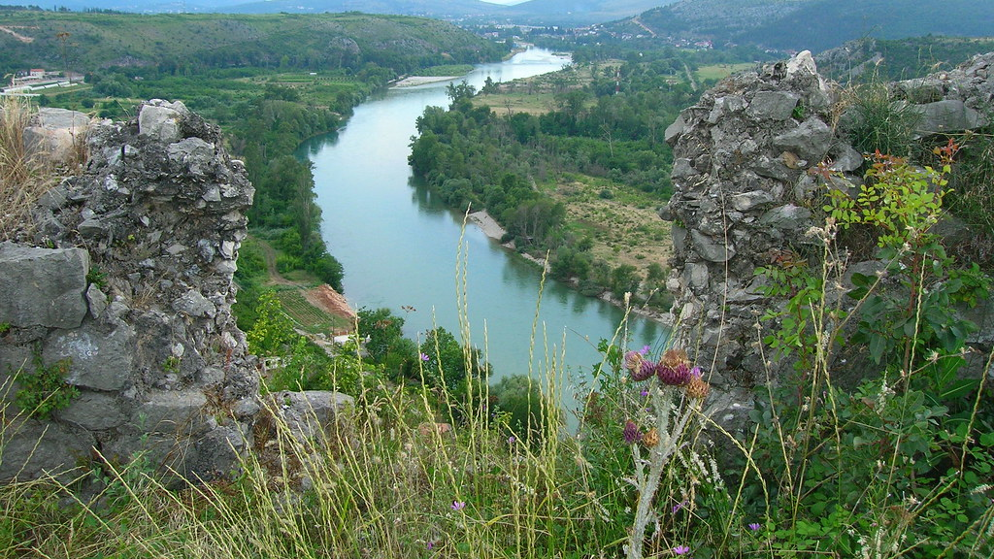
THE END
This Photo by Unknown author is licensed under CC BY-NC.

