Slide 1
Les mythes et les légendes

Slide 2
The beast with big ears
But who is it ?

Slide 3
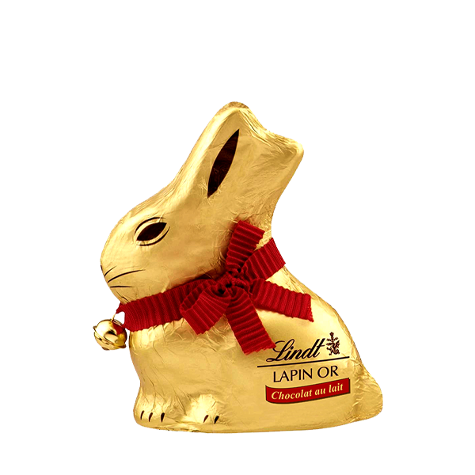
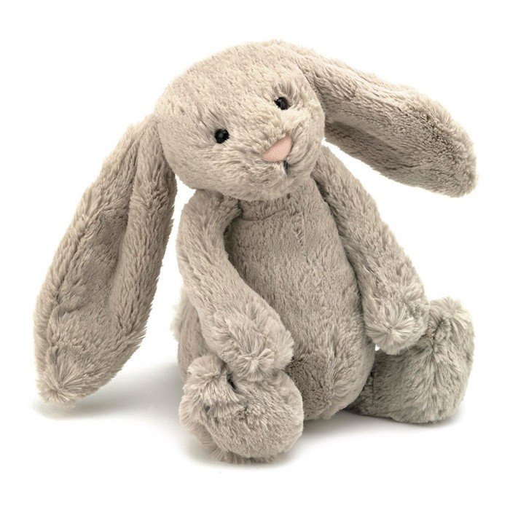
It's a rabbit !

Slide 4
But for whom is it a danger ?

Slide 5
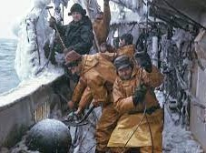
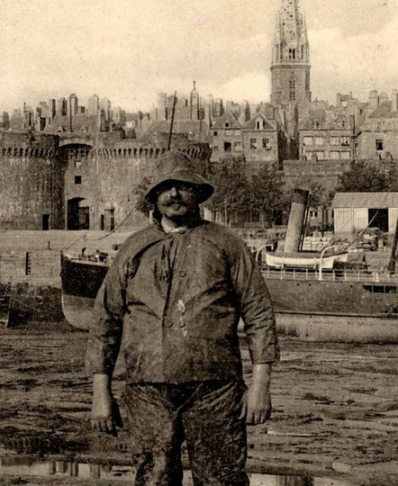
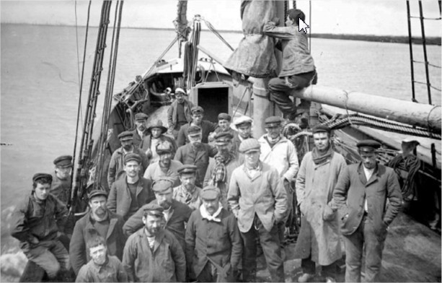
seafarers !

Slide 6
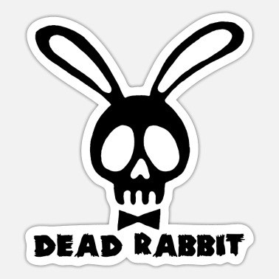
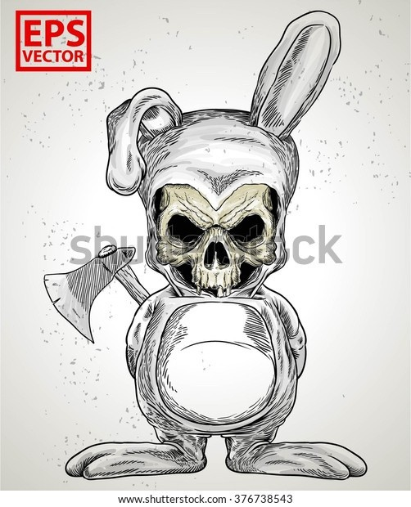
The beast brings misfortune

Slide 7
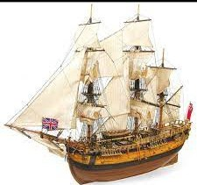
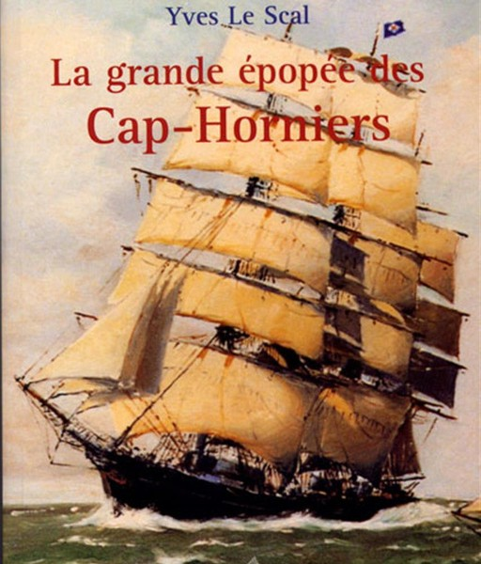
For about 1000 years,
wooden boats with live animals on board.
Rabbits in the laying of the holds gnaw the wood.
The ship is in danger, it can sink.

Slide 8
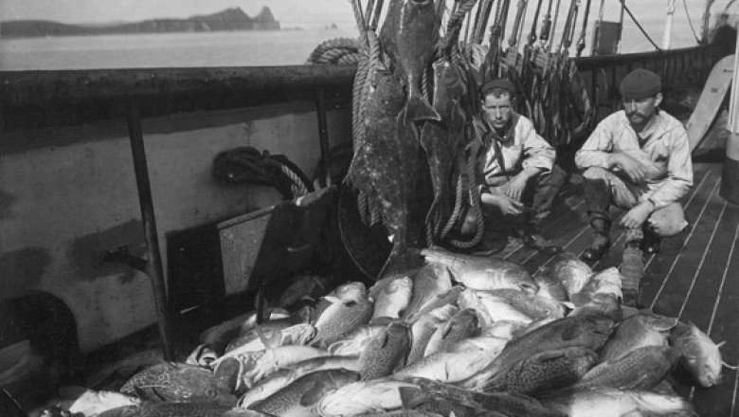
The word must NEVER be used on board.
If someone dares to say the word on board,the bad fate must be warded off.
Examples : throw the sailor or a buoy into the sea

Slide 9
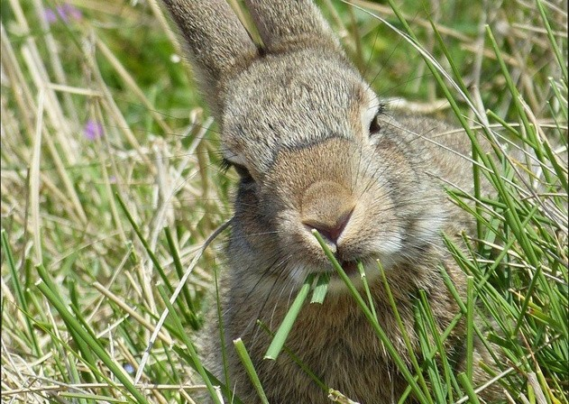
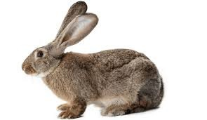
-We don't say rabbit but the beast with big ears, the lobster of meadows or the cousin of the hare.
-Neither do we pronouce the syllabe of this word
Examples : In french, the rabbit is said "lapin", we can't say who painted it because in French is translates as "qui l'a peint"

Slide 10
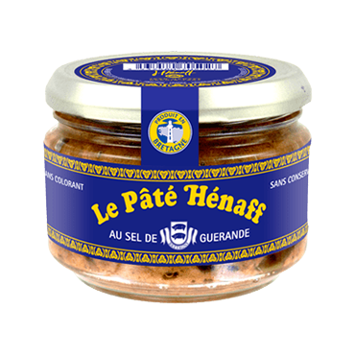
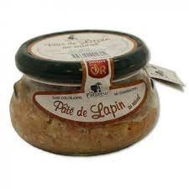
forbidden to eat rabbit pâté on board ; We eat the sailor's pâté, the Henaff !

